Slide 1


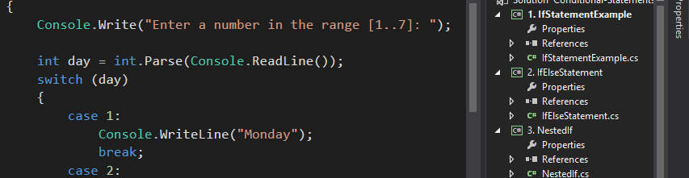

Programming Fundamentals
Course Introduction
coding
SoftUni Team
Technical Trainers
Software University
http://softuni.bg

Slide 2
Questions
sli.do #2811

Slide 3










SoftUni Diamond Partners

Slide 4
Tech Module
Programming Fundamentals Course
Programming Fundamentals Course
Software Technologies Course
HTML + JavaScript
Scope
Trainers
PHP + MySQL
Evaluation
.NET Web
Java Web

Slide 5
Tech Module
Standard C# API
Problem Solving Skills
Programming Fundamentals Course
GitHub and Debugging
Data Types and Methods
Arrays, Lists
Scope
Trainers
Evaluation
Strings, Dictionaries, LINQ
Objects and Classes
Files and Exceptions

Slide 6
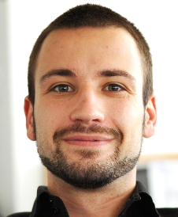
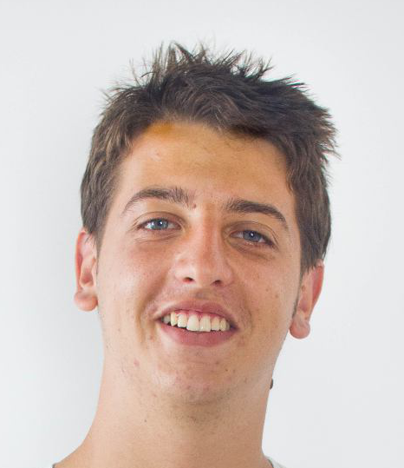
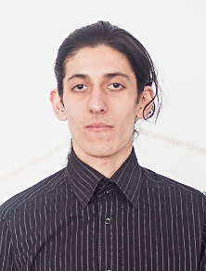
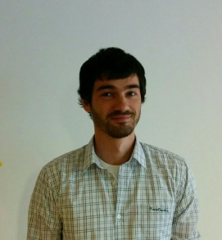
Programming Fundamentals Course
Scope
Trainers
Evaluation

Slide 7
Trainers
Angel Georgiev
Training Director @ Software University (SoftUni)
10 years of experience as trainer
6 years of experience in sales and marketing
4+ years of programming experience

Slide 8
Trainers
Georgi Stoimenov
Technical Trainer @ Software University
Top performing student from the Software University

Slide 9
Trainers
Simeon Sheytanov
Technical Trainer @ Software University
Top performing student from the Software University
Programming experience with C#, Java, C++, Python, JavaScript, PHP, VB, Assembler and other programming languages
Interested in game development

Slide 10
Trainers
Peter Penev
Technical Trainer @ Software University
Top performing student from the Software University
Deep interest in Data Structures & Algorithms

Slide 11
Trainers
Programming Fundamentals Course
Scope
Evaluation

Slide 12
Examination
Activities
Bonuses
80%
20%
10%
Programming Fundamentals Course
Scope
Trainers
Evaluation

Slide 13
Evaluation
Examination
Activities
Bonuses
80%
20%
10%
Attendance
Simple Logic, Formatting
Forum Activity
Arrays, Lists
Strings & RegEx
Exercises (Homework)
Dictionaries

Slide 14
Evaluation
Examination
Activities
Bonuses
80%
20%
10%
Programming Fundamentals Course
Scope
Trainers

Slide 15
Tech Module
Programming Fundamentals Course
Scope
Trainers
Evaluation

Slide 16


Your RFID Chip
Students can either
Take RFID chip from SoftUni
Or use their own chip / card
Register your chip number in your SoftUni profile: https://softuni.bg/users/profile/show
Check-in at the reception every time when you come
See your last visits in your profile: https://softuni.bg/users/profile/show

Slide 17









Resources
What We Need Additionally?

Slide 18

Course Web Site & Forums
The Programming Basics official web site:
Register for the "Software University Forum":
Discuss the course exercises with your colleagues
Find solutions for all course exercises
Share source code / discuss ideas / help each other
https://softuni.bg/courses/programming-fundamentals/
https://softuni.bg/forum/categories/44/

Slide 19



The Programming Basics Slides and Videos
All lecture slides, videos, homework assignments, projects and other resources are open content, available for free
Visit the course web site to access the course resources

Slide 20

The Free C# Fundamentals Textbook
The official textbook for the course
"Fundamentals of Computer Programming with C#", by Svetlin Nakov & Co., 2013, ISBN 9789544007737
English and Bulgarian versions (as PDF, ePub, …)
Freely downloadable from: www.introprogramming.info
The C# Programming courses @ SoftUni.bg partially follows the book
Programming Fundamentals → chapters 2, 3, 7, 9, 11, 13, 14, 16, 18, 22

Slide 21


Required Software
Software needed for this course:
Microsoft Windows (Win 10 / 8.1 / Win8 / Win7)
Visual Studio Community 2015 (a free version of VS 2015)
Visual Studio 2013, 2012, 2010 acceptable, but not recommended
.NET Framework 4.6 (included in Visual Studio)

Slide 22
Programming Fundamentals – Course Intro
https://softuni.bg/courses/programming-fundamentals

Slide 23
License
This course (slides, examples, demos, videos, homework, etc.) is licensed under the "Creative Commons Attribution-NonCommercial-ShareAlike 4.0 International" license
Attribution: this work may contain portions from
"Fundamentals of Computer Programming with C#" book by Svetlin Nakov & Co. under CC-BY-SA license

Slide 24






Free Trainings @ Software University
Software University Foundation – softuni.org
Software University – High-Quality Education, Profession and Job for Software Developers
softuni.bg
Software University @ Facebook
facebook.com/SoftwareUniversity
Software University @ YouTube
youtube.com/SoftwareUniversity
Software University Forums – forum.softuni.bg

